Slide 1
PIZZA_SALE TEMPLATE
We would like to offer you a stylish and reasonable presentation that will help you to promote your business

Slide 2
SQL_PROJECT
PROJECT_ON_PIZZA-SALE_BUSINESS

Slide 3
CREATE PIZZA_HUT
FIRSTLY CREATE PIZZA_HUT DATASET
UPLOAD THE DATASETS FROM CSV
APPLING THE QUERIES TO FIND VALUABLE INSIGHTS.

Slide 4
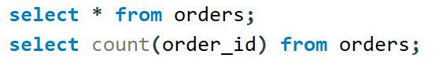
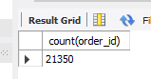
Retrieve the total number of orders placed
Solution:

Slide 5
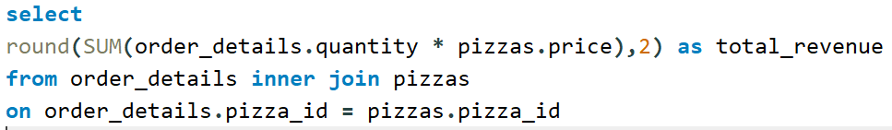
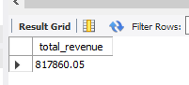
Calculate the total revenue generated from pizza sales.
Solution:

Slide 6
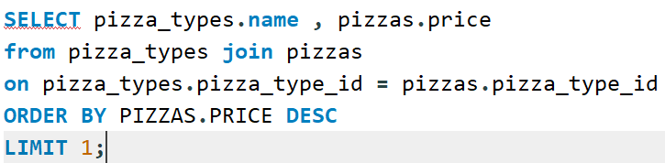
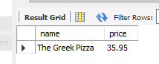
Identify the highest-priced pizza.
Solution:

Slide 7
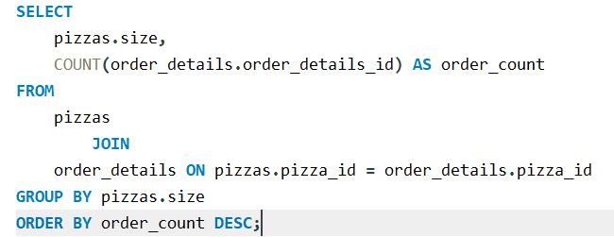
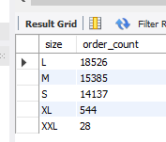
Identify the most common pizza size ordered
Solution:

Slide 8
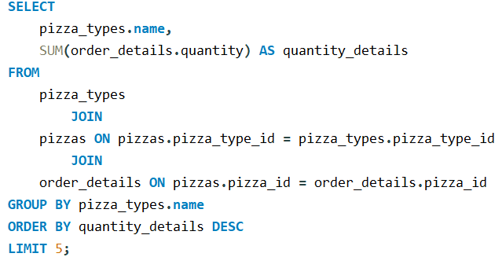
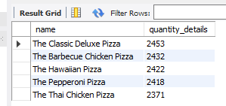
List the top 5 most ordered pizza types along with their quantities.
Solution:

Slide 9
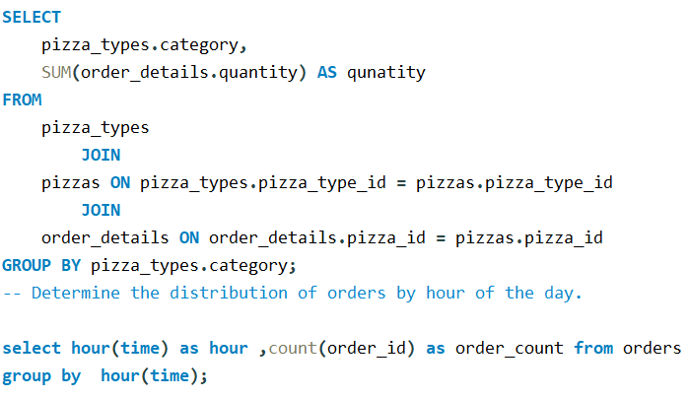
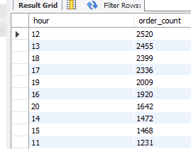
Join the necessary tables to find the total quantity of each pizza category ordered.
Solution:

Slide 10
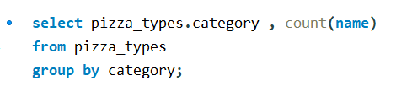
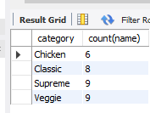
Join relevant tables to find the category-wise distribution of pizzas.
Solution:

Slide 11
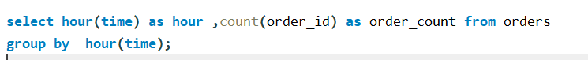
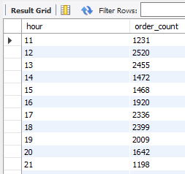
Determine the distribution of orders by hour of the day.
Solution:

Slide 12
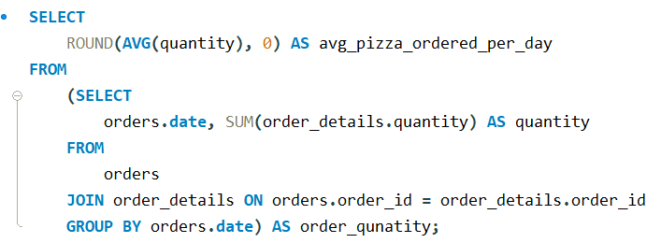
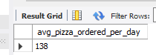
Group the orders by date and calculate the average number of pizzas ordered per day.
Solution:

Slide 13
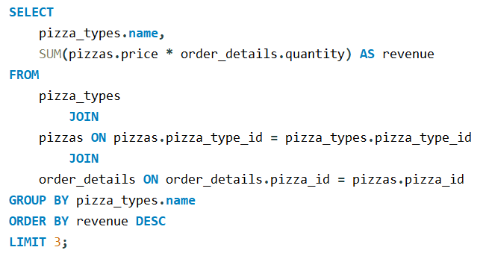
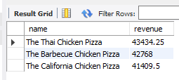
Determine the top 3 most ordered pizza types based on revenue.
Solution:

Slide 14
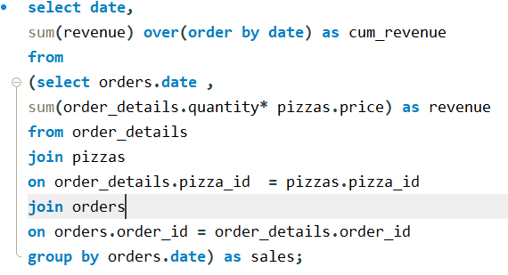
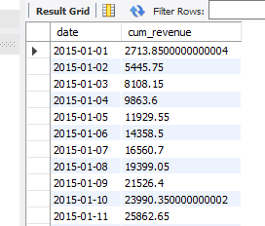
Analyze the cumulative revenue generated over time.
Solution:

Slide 15
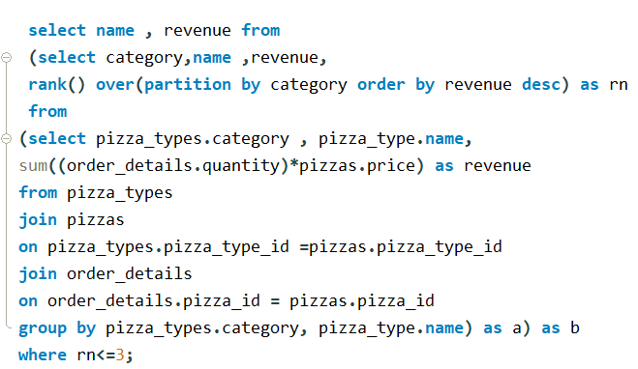
Determine the top 3 most ordered pizza types based on revenue for each pizza category.
Solution:

Slide 16
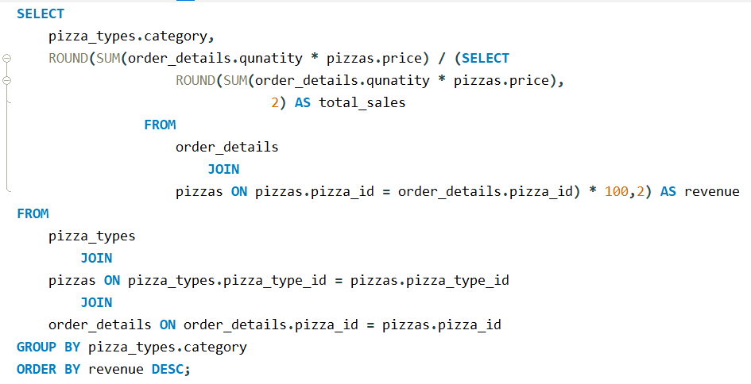
Calculate the percentage contribution of each pizza type to total revenue.
Solution:

Slide 17
WE FIND SOME INSIGHTS FOR PIZZA_SALE
HERE WE FIND THE TOTAL NUMBERS OF ORDER PLACED BY CUSTOMERS.
FIND THE TOTAL REVENUE GENERATED FROM PIZZA SALES.
FIND THE HIGHEST PRICED PIZZA NAME AND AMOUNT.
FIND THE MOST COMMON PIZZA SIZE ORDERD MAXIMUM.
FIND TOP 5 MOST ORDERED PIZZA TYPES WITH HIS QUANTITY.
FIND THE TOTAL QUANTITY OF EACH PIZZA CATEGORY.
FIND THE TOTAL DISTRIBUTION OF PIZZA ON HOUR OF DAY.
FIND THE CATEGORY WISE DISTRIBUTION OF PIZZA.
FIND THE AVERAGE NUMBER OF PIZZA ORDER PER DAY.
FIND THE TOP 3 MOST ORDERED PIZZA BASED ON THE REVENUE.
FIND THE PERCENTAGE CONTRIBUTION OF EACH PIZZA TYPE ACCORDING TO REVENUE.

Slide 18
THANK YOU
SHAHRUKH KHAN

